Slide 1
Smart Distributed waste management system
GEEKcited

Slide 2


For the pity of civilization

Slide 3

Please pick it up!

Slide 4
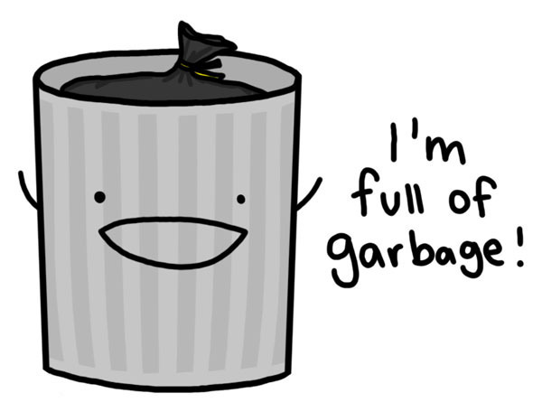
A happy but embarrassed condition

Slide 5

Design for emergency,
But hope you never need it

Slide 6

Design for emergency,
But hope you never hear it

Slide 7
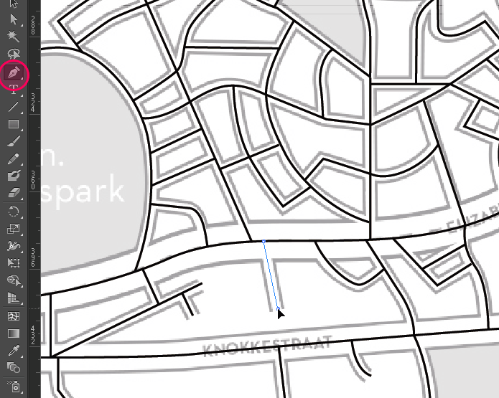
Back to server and send to client

Slide 8

Further explore
What’s in the trash?

Slide 9
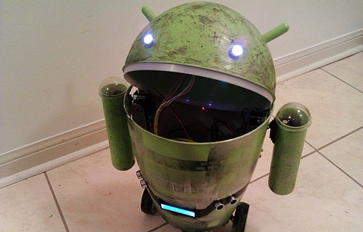
Further explore
Routing planning
Condition statistics
Component analysis

Slide 10
Cloud Service
Distributed Smart Waste Bins
Waste Bin A
Waste Bin B
Waste Management Clients
Waste Management Workers

Slide 11
Cloud Servers
WiFi
Intel Edison
Arduino Uno
Temp
Sensor
IR
Sensor
Buzzer
Alcohol Sensor
Help Button
Other Sensor

